Slide 1
NumPy

Slide 2
Outline
Creating arrays from Existing Data
Array Attributes
Array Operators
NumPy Methods
Shallow Copies
Deep Copies

Slide 3
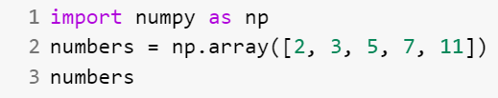



Creating arrays from Existing Data
Code
Output
Check Type
Output

Slide 4




Creating arrays from Existing Data
Multidimensional Arguments
The array function copies its argument’s dimensions. NumPy auto-formats arrays, based on their number of dimensions, aligning the columns within each row.
1D array example:
2D array example:
3D array example:

Slide 5

Creating arrays from Existing Data
Problem 1:
Create a two-dimensional array from a list comprehension that produces the even integers from 2 through 20 in the first row and the odd integers from 1 through 21 in the second row.
Solution:
Exercise:
Create a 2-by-5 array containing reverse order of the even integers from 2 through 10 in the first row and the odd integers from 1 through 9 in the second row.

Slide 6




Array Attributes
An array object provides attributes that enable you to discover information about its structure and contents.

Slide 7
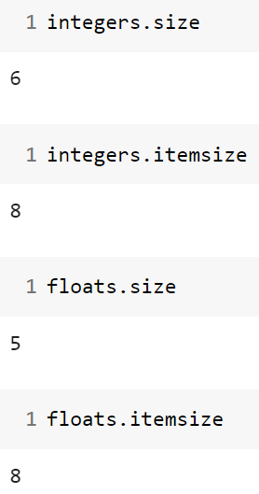
Array Attributes
Checking an array’s Number of Elements and Element Size

Slide 8
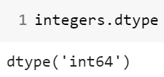
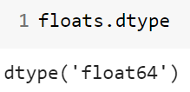

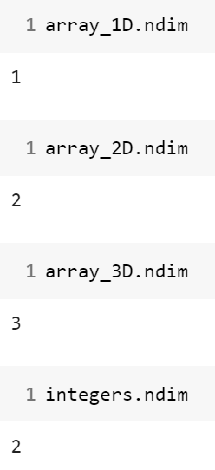
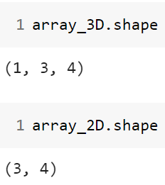
Array Attributes
Checking array’s element types
Checking an array’s Dimensions and Shape

Slide 9
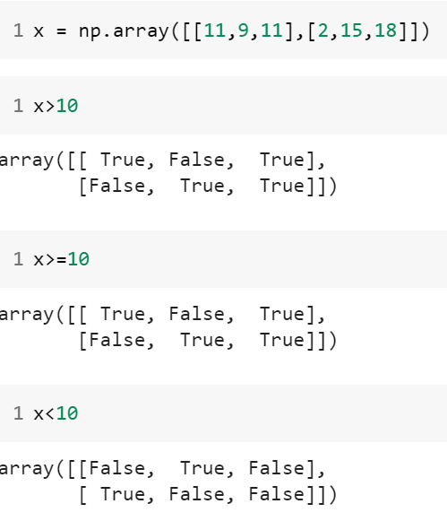
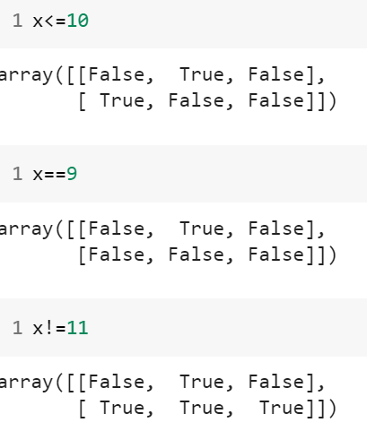
Array Operator

Slide 10
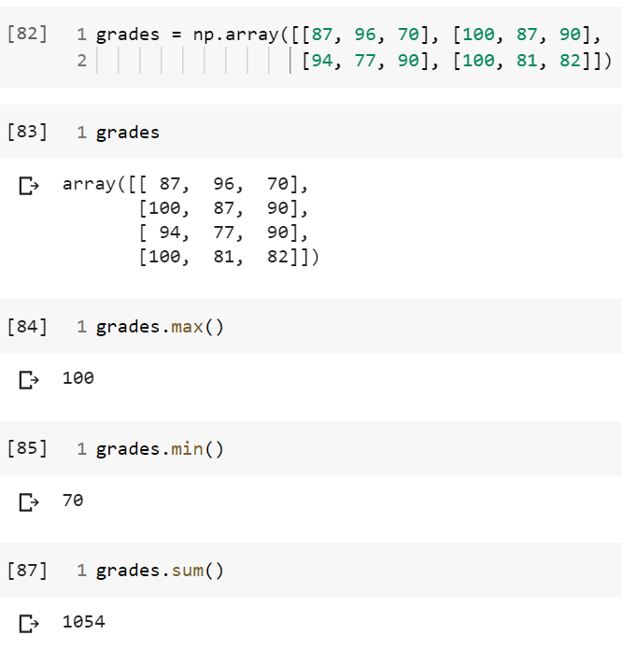
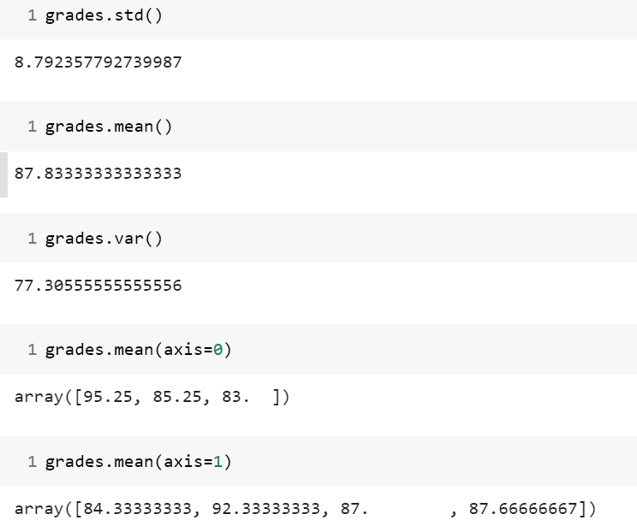
NumPy Methods

Slide 11
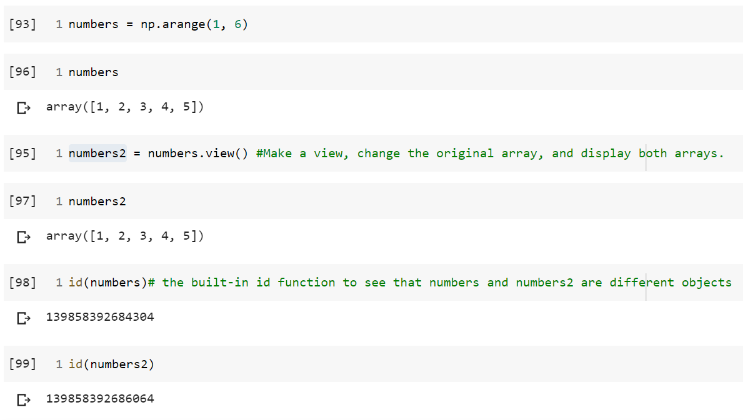
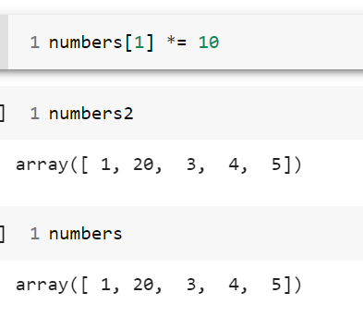
Shallow Copies

Slide 12
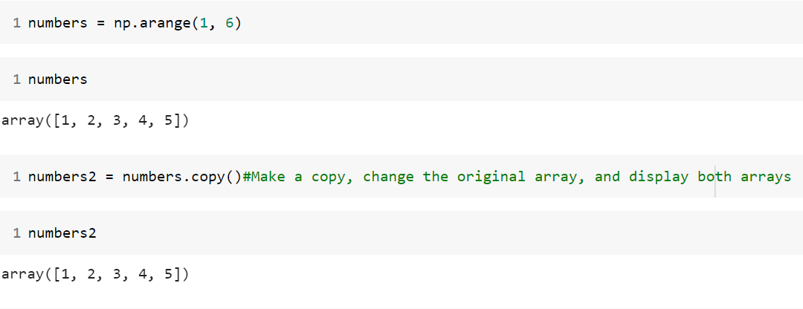
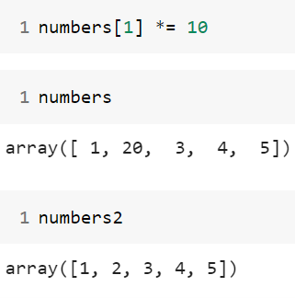
Deep Copies

Slide 13
End

